Slide 1
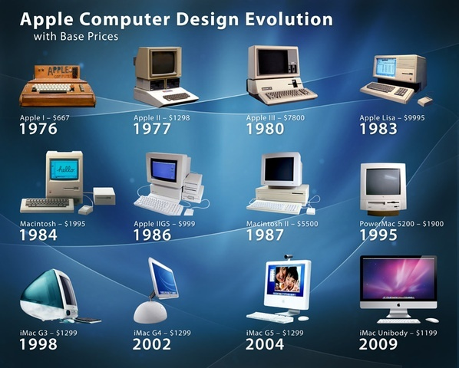
SEN111 CSE111 ICT
Characteristics, Generations and Organization
Lecture 3 (Week 2)
By Mr. Faheem Shaukat
faheem@iqraisb.edu.pk
Github.com/faheemshaukat

Slide 2
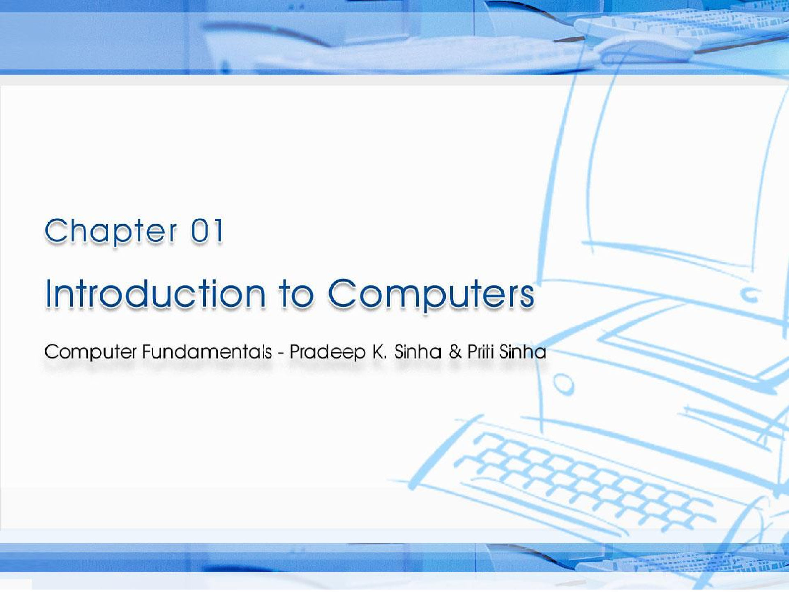
CCoommppuutterer FFununddaammenenttaallss:: PPrradadeeepep KK.. SSiinhanha && PPrriititi SSiinhanha
Ref Page Chapter 1: Introduction to Computers Slide 1/17

Slide 3

Learning Objectives
Computer Fundamentals: Pradeep K. Sinha & Priti Sinha
In this chapter you will learn about:
Computer
Data processing
Characteristic features of computers
Computers’ evolution to their present form
Computer generations
Characteristic features of each computer generation
Ref Page 01

Slide 4
Computer
Computer Fundamentals: Pradeep K. Sinha & Priti Sinha
The word computer comes from the word “compute”, which means, “to calculate”
Thereby, a computer is an electronic device that can perform arithmetic operations at high speed
A computer is also called a data processor because it can store, process, and retrieve data whenever desired
Ref Page 01

Slide 5
Data Processing
Computer Fundamentals: Pradeep K. Sinha & Priti Sinha
The activity of processing data using a computer is called
data processing
Data
Capture Data
Manipulate Data
Output Results
Information
Data is raw material used as input and information is processed data obtained as output of data processing
Ref Page 01

Slide 6
Characteristics of Computers
Computer Fundamentals: Pradeep K. Sinha & Priti Sinha
1) Automatic: Given a job, computer
can work
on it
automatically without human interventions
2) Speed: Computer can perform data processing
jobs
very fast, usually measured in microseconds (10⁻⁶),
nanoseconds (10⁻⁹), and picoseconds (10⁻¹²)
3) Accuracy: Accuracy of a computer is consistently high and the degree of its accuracy depends upon its design. Computer errors caused due to incorrect input data or unreliable programs are often referred to as Garbage- In-Garbage-Out (GIGO)
(Continued on next slide)
Ref Page 02

Slide 7
Characteristics of Computers
Computer Fundamentals: Pradeep K. Sinha & Priti Sinha
(Continued from previous slide..)
Diligence: Computer is free from monotony, tiredness, and lack of concentration. It can continuously work for hours without creating any error and without grumbling
Versatility: Computer is capable of performing almost any task, if the task can be reduced to a finite series of logical steps
6) Power
recall
of Remembering: Computer can store and any amount of information because of its
secondary storage capability. It forgets or looses certain information only when it is asked to do so
(Continued on next slide)
Ref Page 02

Slide 8
Characteristics of Computers
Computer Fundamentals: Pradeep K. Sinha & Priti Sinha
(Continued from previous slide..)
No I.Q.: A computer does only what it is programmed to do. It cannot take its own decision in this regard
No Feelings: Computers are devoid of emotions. Their judgement is based on the instructions given to them in the form of programs that are written by us (human beings)
(Continued on next slide)
Ref Page 03

Slide 9
Evolution of Computers
Computer Fundamentals: Pradeep K. Sinha & Priti Sinha
Blaise Pascal invented the first mechanical adding machine in 1642
Baron Gottfried invented the first calculator for multiplication in 1671
Keyboard machines originated in the United States around 1880
Around 1880, Herman Hollerith came up with the concept of punched cards that were extensively used as input media until late 1970s
Ref Page 03

Slide 10
Evolution of Computers
Computer Fundamentals: Pradeep K. Sinha & Priti Sinha
(Continued from previous slide..)
Charles Babbage is considered to be the father of modern digital computers
He designed “Difference Engine” in 1822
He designed a fully automatic analytical engine in 1842 for performing basic arithmetic functions
His efforts established a number of principles that are fundamental to the design of any digital computer
(Continued on next slide)
Ref Page 03

Slide 11
Some Well Known Early Computers
Computer Fundamentals: Pradeep K. Sinha & Priti Sinha
The Mark I Computer (1937-44)
The Atanasoff-Berry Computer (1939-42)
▪ The ENIAC (1943-46)
▪ The EDVAC (1946-52)
▪ The EDSAC (1947-49)
Manchester Mark I (1948)
The UNIVAC I (1951)
Ref Page 03

Slide 12
Computer Generations
Computer Fundamentals: Pradeep K. Sinha & Priti Sinha
“Generation” in computer talk is a step in technology. It provides a framework for the growth of computer industry
Originally it was used to distinguish between various hardware technologies, but now it has been extended to include both hardware and software
Till today, there are five computer generations
(Continued on next slide)
Ref Page 05

Slide 13
Computer Generations
Computer Fundamentals: Pradeep K. Sinha & Priti Sinha
(Continued from previous slide..)
Generation (Period) | Key hardware technologies | Key software technologies | Key characteristics | Some representative systems
First (1942-1955) | Vacuum tubes Electromagnetic relay memory Punched cards secondary storage | Machine and assembly languages Stored program concept Mostly scientific applications | Bulky in size Highly unreliable Limited commercial use and costly Difficult commercial production Difficult to use | ENIAC EDVAC EDSAC UNIVAC I IBM 701
Second (1955-1964) | Transistors Magnetic cores memory Magnetic tapes Disks for secondary storage | Batch operating system High-level programming languages Scientific and commercial applications | Faster, smaller, more reliable and easier to program than previous generation systems Commercial production was still difficult and costly | Honeywell 400 ▪ IBM 7030 ▪ CDC 1604 UNIVAC LARC
(Continued on next slide)
Ref Page 13

Slide 14
Computer Generations
Computer Fundamentals: Pradeep K. Sinha & Priti Sinha
(Continued from previous slide..)
Generation (Period) | Key hardware technologies | Key software technologies | Key characteristics | Some rep. systems
Third (1964-1975) | ICs with SSI and MSI technologies Larger magnetic cores memory Larger capacity disks and magnetic tapes secondary storage Minicomputers; upward compatible family of computers | Timesharing operating system Standardization of high-level programming languages Unbundling of software from hardware | Faster, smaller, more reliable, easier and cheaper to produce Commercially, easier to use, and easier to upgrade than previous generation systems Scientific, commercial and interactive on- line applications | ▪ IBM 360/370 PDP-8 PDP-11 ▪ CDC 6600
(Continued on next slide)
Ref Page 13

Slide 15
Computer Generations
Computer Fundamentals: Pradeep K. Sinha & Priti Sinha
(Continued from previous slide..)
Generation (Period) | Key hardware Technologies | Key software technologies | Key characteristics | Some rep. systems
Fourth (1975-1989) | ICs with VLSI technology Microprocessors; semiconductor memory Larger capacity hard disks as in-built secondary storage Magnetic tapes and floppy disks as portable storage media Personal computers Supercomputers based on parallel vector processing and symmetric multiprocessing technologies Spread of high-speed computer networks | Operating systems for PCs with GUI and multiple windows on a single terminal screen Multiprocessing OS with concurrent programming languages UNIX operating system with C programming language Object-oriented design and programming PC, Network-based, and supercomputing applications | Small, affordable, reliable, and easy to use PCs More powerful and reliable mainframe systems and supercomputers Totally general purpose machines Easier to produce commercially Easier to upgrade Rapid software development possible | IBM PC and its clones Apple II TRS-80 ▪ VAX 9000 CRAY-1 CRAY-2 CRAY-X/MP
(Continued on next slide)
Ref Page 13

Slide 16
Computer Generations
Computer Fundamentals: Pradeep K. Sinha & Priti Sinha
(Continued from previous slide..)
Generation (Period) | Key hardware technologies | Key software technologies | Key characteristics | Some rep. systems
Fifth (1989- Present) | ICs with ULSI technology Larger capacity main memory, hard disks with RAID support Optical disks as portable read-only storage media Notebooks, powerful desktop PCs and workstations Powerful servers, supercomputers Internet Cluster computing | Micro-kernel based, multithreading, distributed OS Parallel programming libraries like MPI & PVM JAVA World Wide Web Multimedia, Internet applications More complex supercomputing applications | Portable computers Powerful, cheaper, reliable, and easier to use desktop machines Powerful supercomputers High uptime due to hot-pluggable components Totally general purpose machines Easier to produce commercially, easier to upgrade Rapid software development possible | IBM notebooks Pentium PCs SUN Workstations IBM SP/2 SGI Origin 2000 PARAM 10000
Ref Page 13

Slide 17
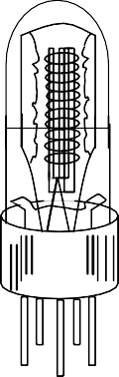
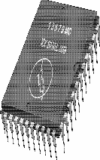

Computer Fundamentals: Pradeep K. Sinha & Priti Sinha
Electronic Devices Used in Computers of Different Generations
(a) A Vacuum Tube
(b) A Transistor
(c) An IC Chip
Ref Page 07

Slide 18
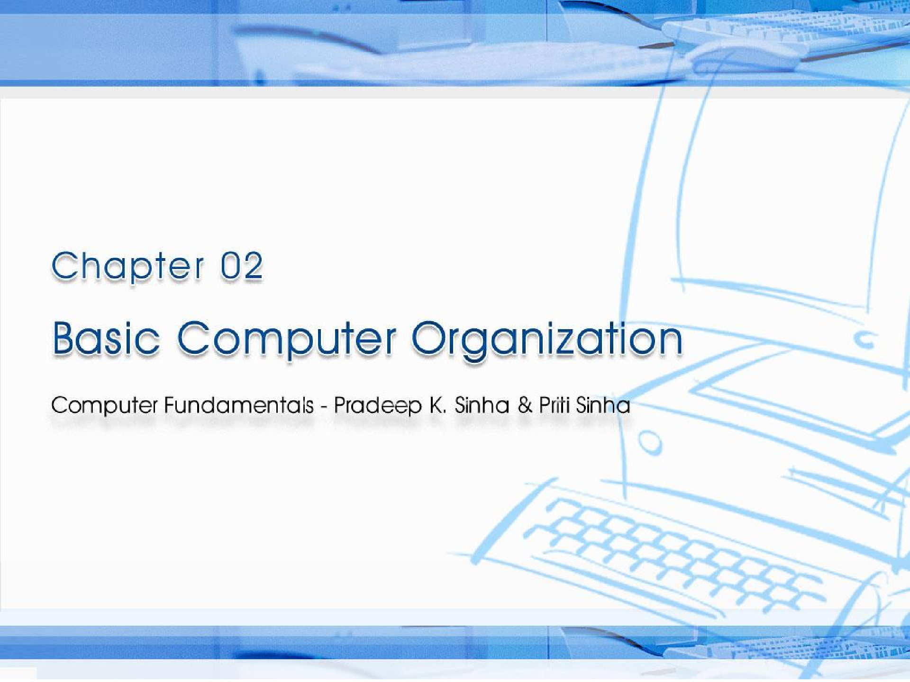
CCoommppuutterer FFununddaammenenttaallss:: PPrradadeeeepp KK.. SSiinhnhaa && PPrriititi SSiinhanha
^{Ref. Page} Chapter 2: Basic Computer Organization Slide 1/16

Slide 19
Learning Objectives
Computer Fundamentals: Pradeep K. Sinha & Priti Sinha
In this chapter you will learn about:
Basic operations performed by all types of computer systems
Basic organization of a computer system
Input unit and its functions
Output unit and its functions
Storage unit and its functions
Types of storage used in a computer system
(Continued on next slide)
15

Slide 20
Learning Objectives
Computer Fundamentals: Pradeep K. Sinha & Priti Sinha
(Continued from previous slide..)
Arithmetic Logic Unit (ALU)
Control Unit (CU)
Central Processing Unit (CPU)
Computer as a system
15

Slide 21
The Five Basic Operations of a Computer System
Computer Fundamentals: Pradeep K. Sinha & Priti Sinha
Inputting. The process of entering data and instructions into the computer system
Storing. Saving data and instructions to make them readily available for initial or additional processing whenever required
Processing. Performing arithmetic operations (add, subtract, multiply, divide, etc.) or logical operations (comparisons like equal to, less than, greater than, etc.) on data to convert them into useful information
(Continued on next slide)
15

Slide 22
The Five Basic Operations of a Computer System
Computer Fundamentals: Pradeep K. Sinha & Priti Sinha
Outputting. The process of producing useful information or results for the user such as a printed report or visual display
Controlling. Directing the manner and sequence in which all of the above operations are performed
15

Slide 23
Basic Organization of a Computer System
Computer Fundamentals: Pradeep K. Sinha & Priti Sinha
Storage Unit
Secondary Storage
Program and Data
Input Unit
Output Unit
Information (Results)
Primary Storage
Control Unit
Indicates flow of instructions and data
Arithmetic Logic Unit
Indicates the control exercised by the control unit
Central Processing Unit (CPU)
16

Slide 24
Input Unit
Computer Fundamentals: Pradeep K. Sinha & Priti Sinha
An input unit of a computer system performs the following functions:
It accepts (or reads) instructions and data from outside world
It converts these instructions and data in computer acceptable form
It supplies the converted instructions and data to the computer system for further processing
16

Slide 25
Output Unit
Computer Fundamentals: Pradeep K. Sinha & Priti Sinha
An output unit of a computer system performs the following functions:
It accepts the results produced by the computer, which are in coded form and hence, cannot be easily understood by us
It converts these coded results to human acceptable (readable) form
It supplies the converted results to outside world
16

Slide 26
Storage Unit
Computer Fundamentals: Pradeep K. Sinha & Priti Sinha
The storage unit of a computer system holds (or stores) the following :
Data and instructions required for processing (received from input devices)
Intermediate results of processing
Final results of processing, before they are released to an output device
17

Slide 27
Two Types of Storage
Computer Fundamentals: Pradeep K. Sinha & Priti Sinha
Primary storage
Used to hold running program instructions
Used to hold data, intermediate results, and results of ongoing processing of job(s)
Fast in operation
Small Capacity
Expensive
Volatile (looses data on power dissipation)
(Continued on next slide)
17

Slide 28
Two Types of Storage
Computer Fundamentals: Pradeep K. Sinha & Priti Sinha
(Continued from previous slide..)
Secondary storage
Used to hold stored program instructions
Used to hold data and information of stored jobs
Slower than primary storage
Large Capacity
Lot cheaper that primary storage
Retains data even without power
17

Slide 29
Arithmetic Logic Unit (ALU)
Computer Fundamentals: Pradeep K. Sinha & Priti Sinha
Arithmetic Logic Unit of a computer system is the place where the actual executions of instructions takes place during processing operation
18

Slide 30
Control Unit (CU)
Computer Fundamentals: Pradeep K. Sinha & Priti Sinha
Control Unit of a computer system manages and coordinates the operations of all other components of the computer system
18

Slide 31
Central Processing Unit (CPU)
Computer Fundamentals: Pradeep K. Sinha & Priti Sinha
Arithmetic Logic Unit (ALU)
Control Unit (CU)
Central Processing Unit (CPU)
+
=
It is the brain of a computer system
It is responsible for controlling the operations of all other units of a computer system
18

Slide 32
The System Concept
Computer Fundamentals: Pradeep K. Sinha & Priti Sinha
A system has following three characteristics:
A system has more than one element
All elements of a system are logically related
All elements of a system are controlled in a manner to achieve the system goal
A computer is a system as it comprises of integrated components (input unit, output unit, storage unit, and CPU) that work together to perform the steps called for in the executing program
18

